Slide 1


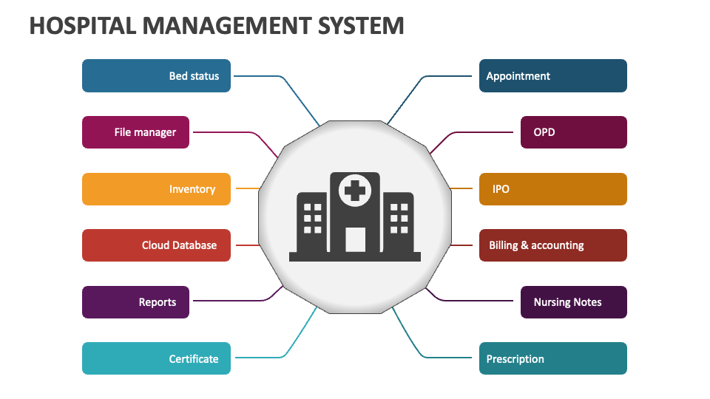
Hospital Management and Availability Checking System
This system aims to streamline hospital operations, improve patient care, and enhance staff productivity through real-time data tracking and analysis.
by adarsh tiwari

Slide 2

Introducing the Hospital Management System
1
Real-Time Tracking
2
Data-Driven Decisions
The system monitors patient flow, bed availability, and staff schedules in real-time to optimize resource allocation.
Comprehensive analytics provide hospitals with insights to improve operations, patient outcomes, and overall efficiency.
3
Improved Access
Patients can easily check bed availability and wait times, enhancing their experience and satisfaction.

Slide 3
Pros of the Hospital Management System
Improved Patient Care
Increased Efficiency
Cost Savings
The system enables hospitals to respond quickly to patient needs, prioritize cases, and ensure timely treatment.
By optimizing resource allocation and reducing wait times, the system boosts overall hospital productivity.
Efficient management of beds, staff, and supplies can lead to significant cost reductions for hospitals.

Slide 4
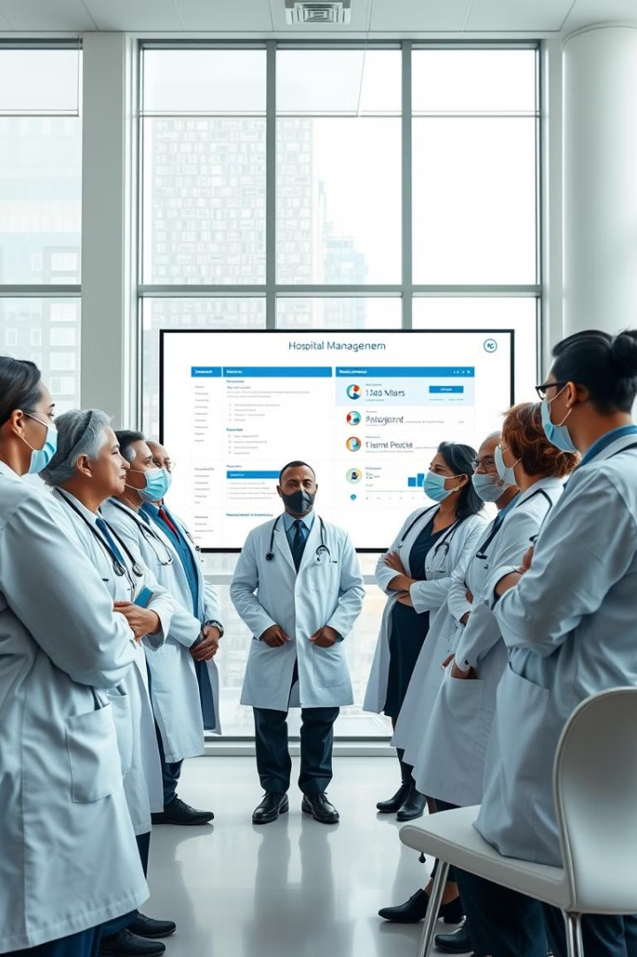
Potential Drawbacks of the System
Privacy Concerns
Implementation Costs
Handling sensitive patient data requires robust security measures to protect individual privacy.
Deploying the system may require significant initial investments in hardware, software, and training.
Technological Challenges
Integrating the system with existing hospital infrastructure and maintaining real-time data accuracy can pose technical hurdles.

Slide 5

Integrating the Hospital Management System
1
Assess Current Systems
Evaluate existing hospital infrastructure and identify areas for integration with the new management system.
2
Develop Integration Plan
Create a comprehensive plan to seamlessly incorporate the new system while minimizing disruptions to hospital operations.
3
Implement and Test
Gradually roll out the system, conducting thorough testing and making necessary adjustments along the way.

Slide 6



Ensuring Smooth Implementation
User Training
Provide comprehensive training to hospital staff to familiarize them with the new system and its features.
Change Management
Develop effective strategies to address user concerns and facilitate a smooth transition to the new system.
Continuous Improvement
Regularly monitor user feedback and system performance, making iterative enhancements to optimize the system.

Slide 7




Safeguarding Data and Compliance
Data Encryption
Implement robust encryption algorithms to protect sensitive patient information from unauthorized access.
Access Controls
Establish strict user authentication and authorization protocols to ensure data is only accessed by authorized personnel.
Regulatory Compliance
Ensure the system meets all relevant healthcare data privacy and security regulations, such as HIPAA.

Slide 8

Measuring the System's Impact
Key Performance Indicators
Baseline Metrics
Target Improvements
Patient Satisfaction
85%
90%
Staff Productivity
78%
85%
Bed Utilization
82%
90%

Slide 9
Balancing the Tradeoffs
Weighing the Benefits
Addressing the Challenges
Continuous Evaluation
The system's potential to improve patient care, increase efficiency, and reduce costs must be carefully considered.
Proactive measures must be taken to mitigate privacy concerns, manage implementation costs, and overcome technical hurdles.
Regular performance assessments and a willingness to adapt will ensure the system remains effective and beneficial.

